Slide 1


Team1
Carriage R1 Github
Fall 2021
Vihan Parmar
Mady Dembele
Roneil Boodram
Lang Gong
George Lopez
Jevon Cowell
Tianqi Han
Maisha Masnoon

Slide 2
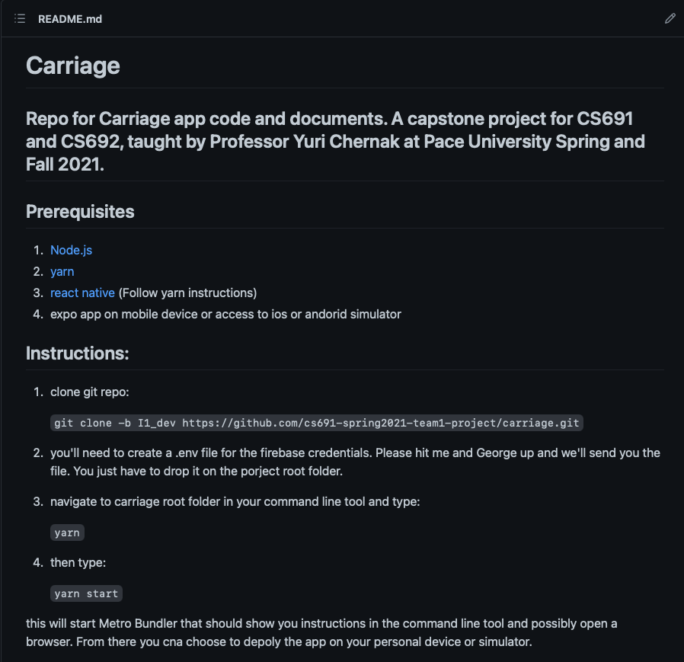
Prerequisites & Installation Instructions

Slide 3
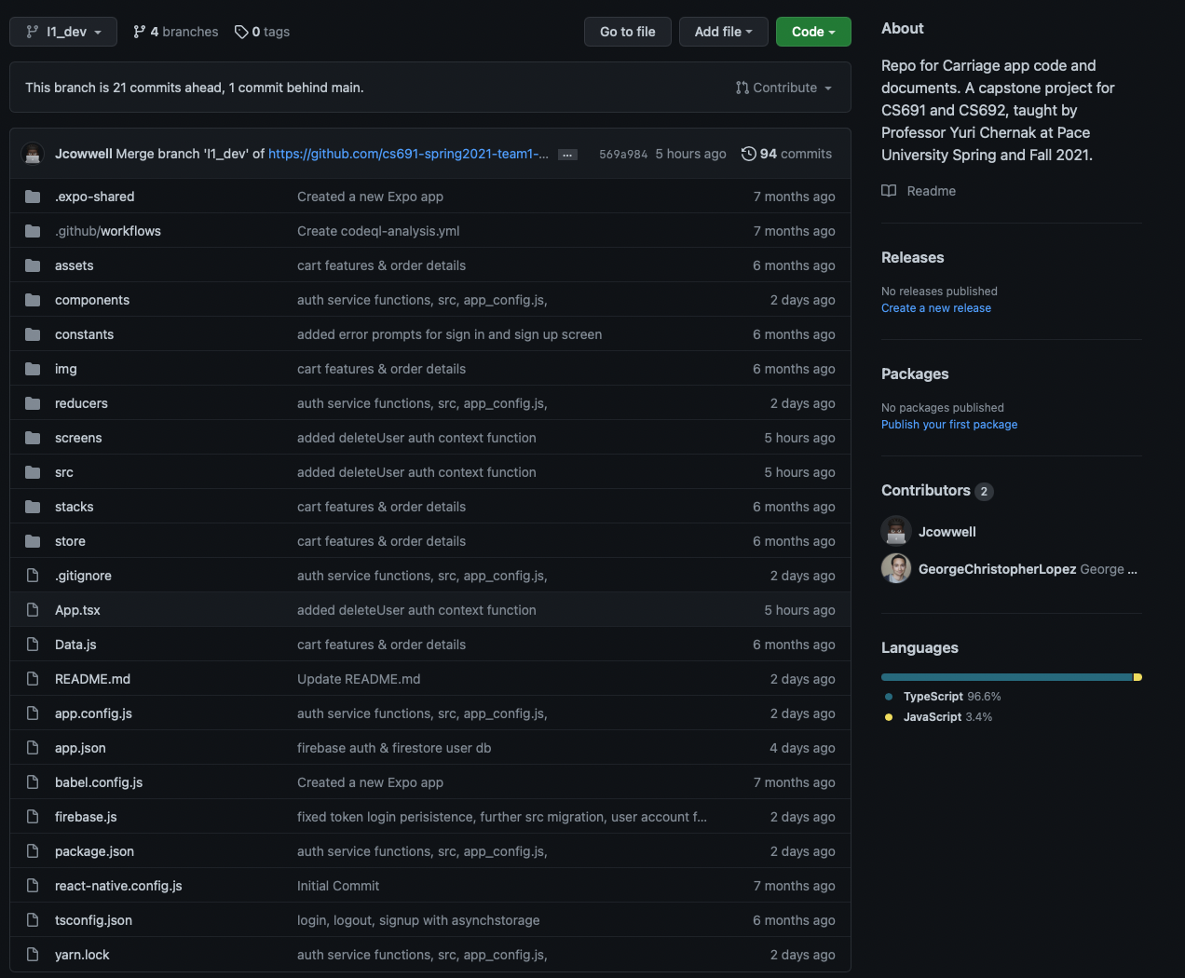
Project Structure

Slide 4
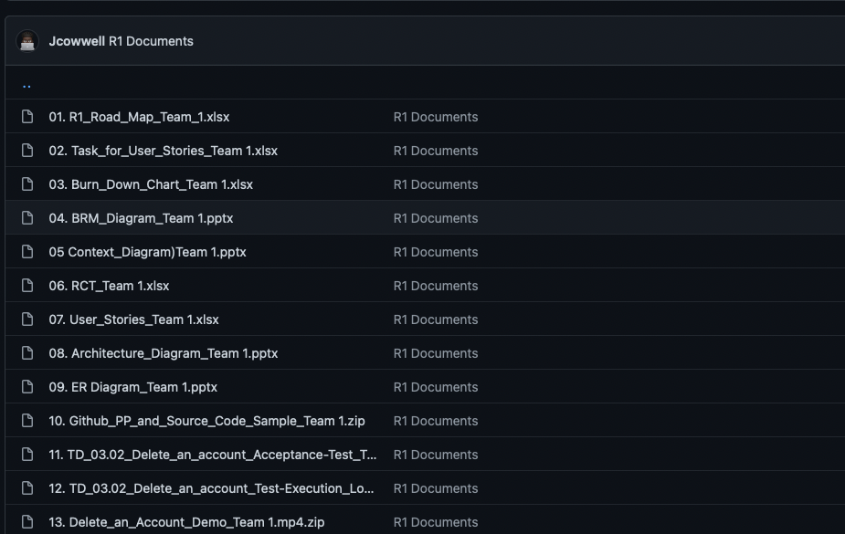
R1 Documents

Slide 5
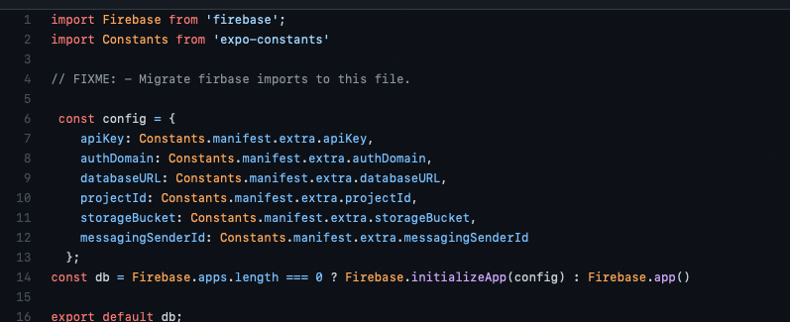
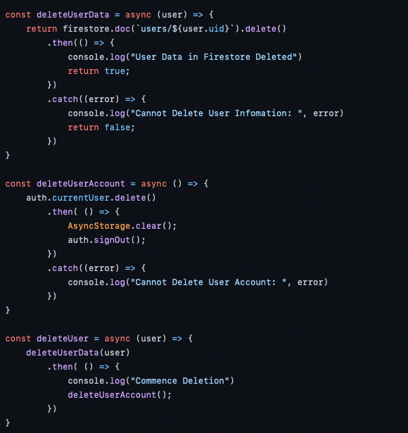

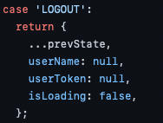
Delete An Account

Slide 6
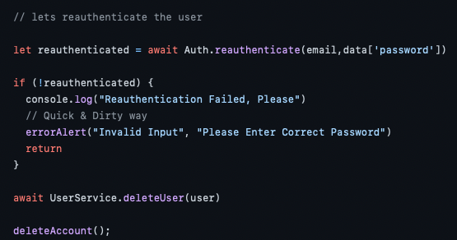

Slide 7
Thank you!

